Slide 1

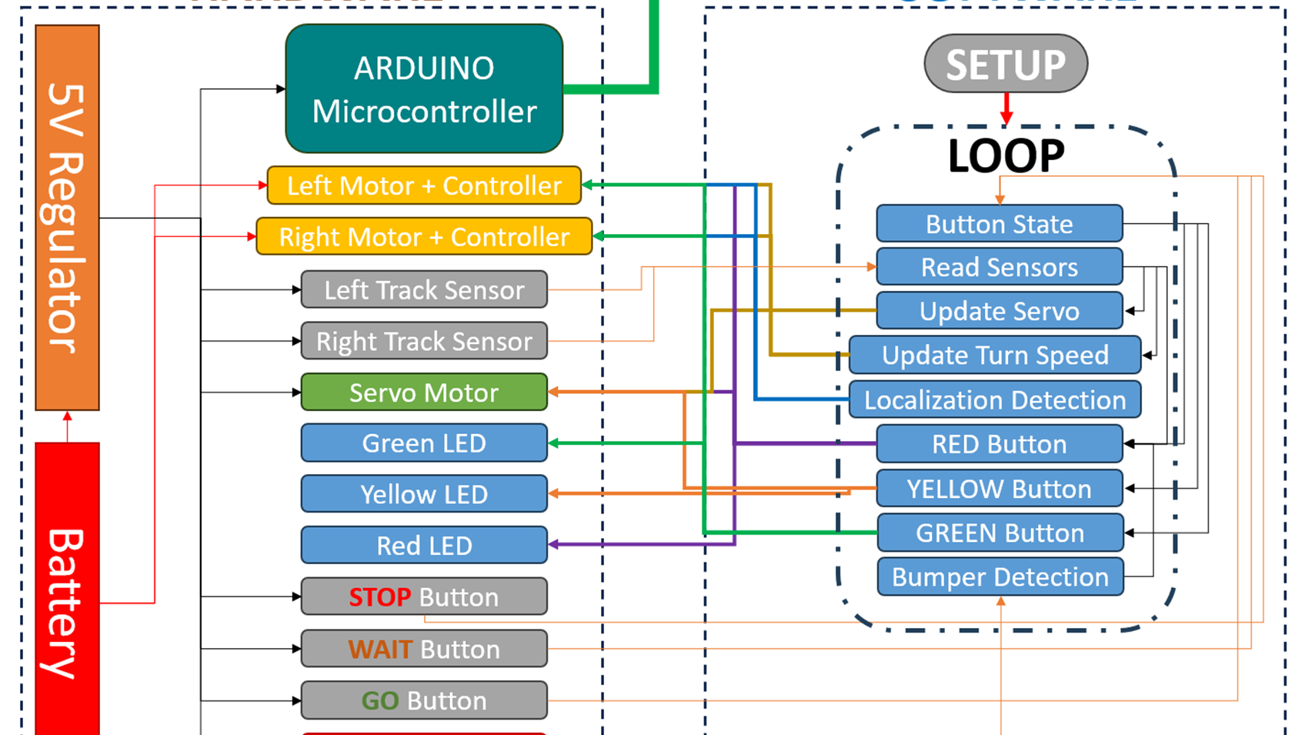
Final Presentation: Real-Time Systems Lab
Group Name: Short Circuits
(Nicholas George, Mady Hines, Riley Hudson, Jacob Vaught)

Slide 2

Agenda
Team Introduction
Team Organization
Project Overview
Design Philosophy
Project Status
Problems and Concerns
Mady's Technical Contributions- [insert Subsystem]
Jacob's Technical Contributions- [insert Subsystem]
Nicholas' Technical Contributions- [insert Subsystem]
Riley's Technical Contributions- [insert Subsystem]
Conclusion
Questions
Notes:
**Order of Speakers/Team Members can be rearranged.
*We can split up who presents Agenda 1 – 6.
Key Components and Processes
Full System Block Diagram
Code Block Diagram
Lab 1: Open-Loop Control and Feedback Measurement
Lab 2: Model Identification
Lab 3: Control Design and Implementation
Lab 5: Subsystem Integration- Combination and State Logic
Lab 6: PID Control Design

Slide 3
Project Description
This project involves the development of an electric autonomous car that integrates advanced control systems and mechatronics. The focus is on designing and implementing real-time embedded control applications, modeling and analyzing mechatronic systems, and developing efficient control strategies using both open-loop and closed-loop systems.

Slide 4
Key Components and Processes
Real-Time Embedded Control: Implementation of sensor inputs and control outputs in a high-speed, real-time embedded control environment.
Mechatronic System Modeling: Derivation and modeling of the transfer function for the car's mechatronic systems.
PID Controller Design and Analysis: Utilizing a transfer function approach for the design and analysis of a PID controller, ensuring effective system regulation and response.
Embedded Programming: Development and programming of a time-critical application on an embedded controller using C/C++ language, focusing on efficiency and reliability.
Matlab/Simulink Integration: Application of Matlab/Simulink for aiding in microcontroller programming, enhancing the control system’s design and simulation process.
Embedded System Design: Executing key steps in embedded systems design, encompassing functional decomposition, subsystem design, and integration of software and hardware components.

Slide 5

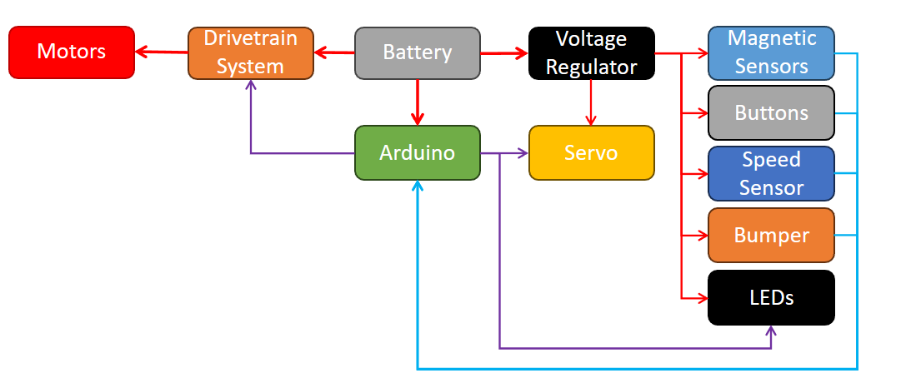

Full System Block Diagram

Slide 6
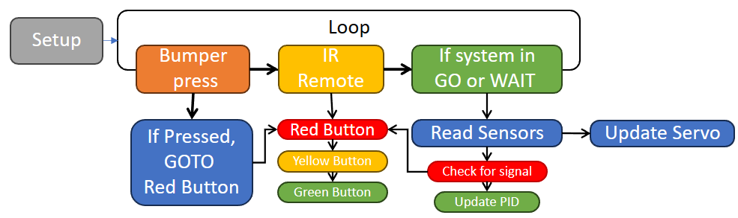
Code Block Diagram

Slide 7

Lab 1: Open-Loop Control and Feedback Measurement

Slide 8
General Objectives
Driving
Steering
Use programming techniques to solidify understanding of microcontroller features.
Demonstrate understanding and implementation of open-loop DC motor control.
Determine the speed to voltage relationship of the DC motor
Develop and execute a steering mechanism employing principles of resonance, amplification, and rectification.
Construct and put into operation a servo-position control system for steering purposes.

Slide 9
Main Specifications
Driving
Steering
Motor Voltage: 7.2V
Switching Frequency: ≥ 20 kHz
Speed Range: 0-100%
External Voltage Reference: 0-3.3V
Feedback: Internal Encoder
Servo voltage: 4.8V - 6V
Communication frequency: 50Hz
Servo Rotational range: 180⁰
Feedback: LC circuit for a given inductance (at 20 kHz)

Slide 10
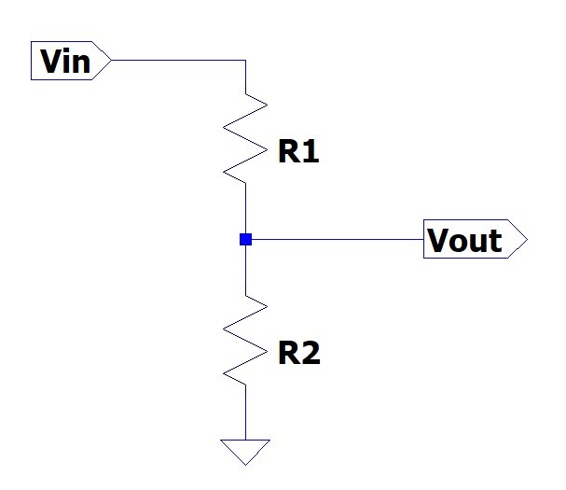
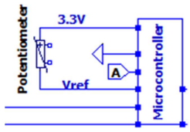
Open-Loop Control Potentiometer and PWM
Input voltage from 3.3V pin on microcontroller
Output voltage (0-3.3V) into analog input pin
AnalogIn potV(A0);
Set period of PW for both motors (25 kHz)
poutLM.period(1.0f/25E3f);
poutRM.period(1.0f/25E3f);
Read the incoming voltage from potentiometer
vref = potV.read();
Notes:
Driving Team

Slide 11
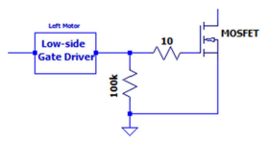
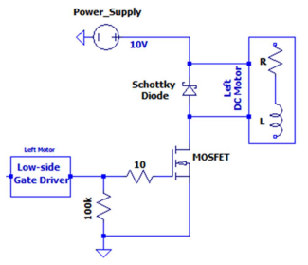
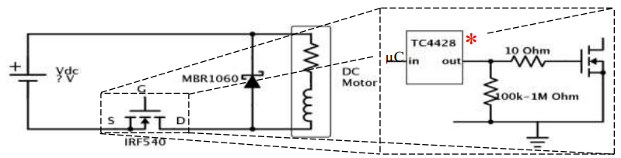
Open-Loop Control Buck Converter (I)
DC-DC step down (Buck) converter
Used to control voltage to motor
Uses PWM signal to achieve desired voltage
When switch is ON the inductor stores energy in its magnetic field
When switch is OFF the stored energy is delivered through the diode to the load filtered by a capacitor
Motor acts as the inductor and load resistor
Notes:
Gate driver increases current and inverts waveform.

Slide 12
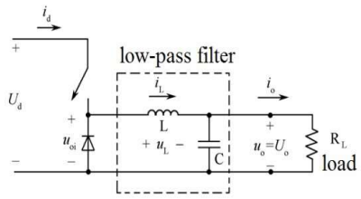

Open-Loop Control Buck Converter (II)
MBR1060
Schottky Diode
Metal-semiconductor junction diode
Fast switching
Low voltage drop
IRF540
N-channel MOSFET
$v_{th}=2V$
*Motor generates internal capacitance and inductance to complete Buck converter

Slide 13
Open-Loop Control Buck Converter (III)

Slide 14
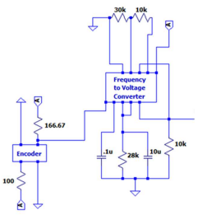
Speed Measurement Tachometer
Nicholas George
Encoder
A device which converts a mechanical information of a shaft or position into an electrical signal
Frequency to Voltage Converter
A device that generates an output voltage or current proportional to the frequency of a sinusoidal input signal.

Slide 15
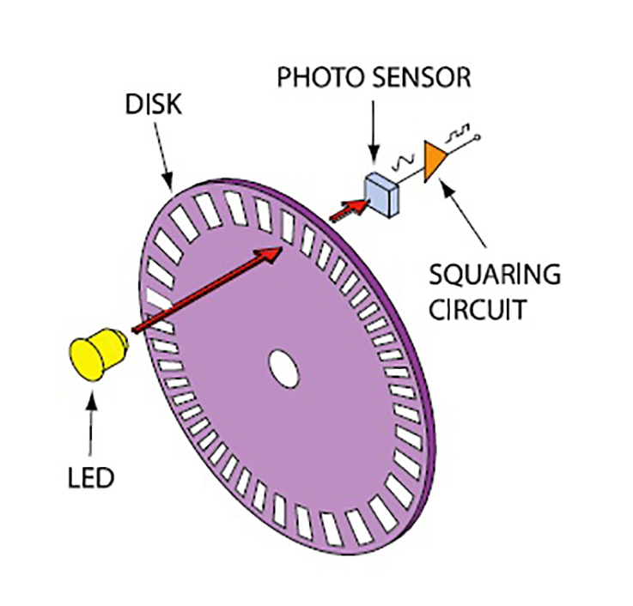
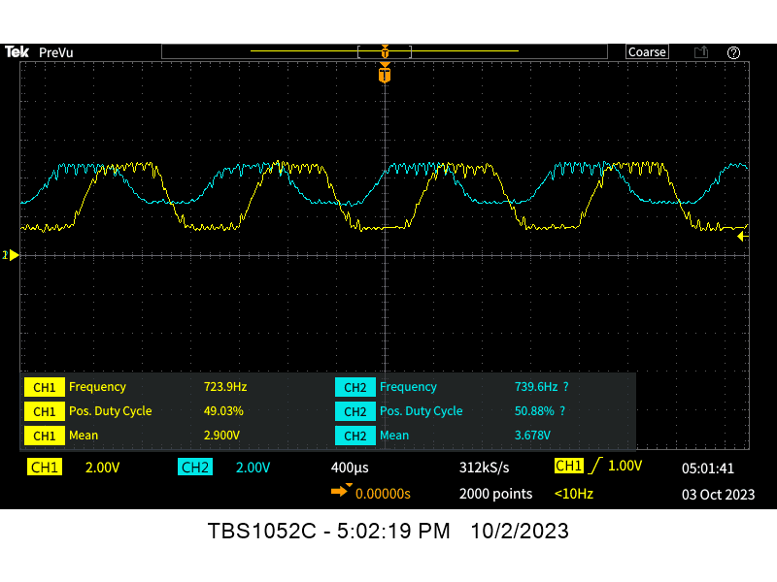
Speed Measurement Encoder (OPB829AZ)
Nicholas George
The optical sensor utilized works as a slotted optical switch. The device consists of an infrared light emitting diode and a NPN phototransistor. When the light emitted from the LED goes through one of the 16 slits of the wheel and hits the phototransistor, an electrical pulse is generated. This creates the switching waveform that represents the frequency of the tire rotation.

Slide 16
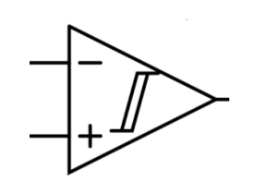
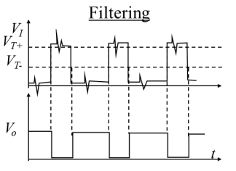
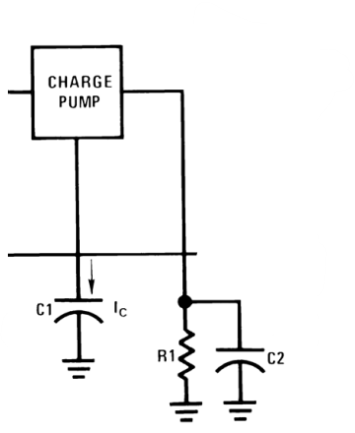
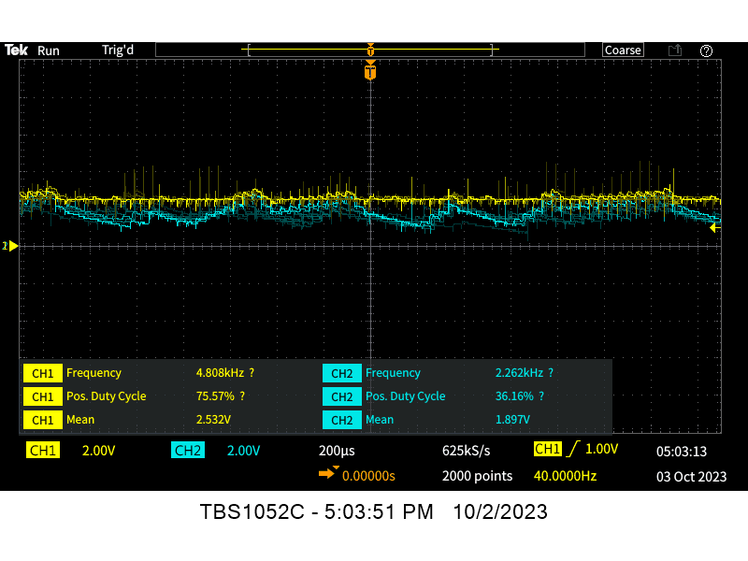
Speed Measurement Frequency to Voltage Converter (LM2907N)
Nicholas George
Schmitt Trigger
Different switching thresholds for positive and negative-going inputs
Turn a noisy or slowly varying input into a clean output
Hysteresis voltage: The voltage range between UTP & LTP
Charge Pump
A charge pump system is used to translate the frequency of a square wave to a voltage. At the start of every positive half cycle of the input signal a 180-µA constant current charges C1 until its voltage has increased by VCC/2. The capacitor is held at that voltage until the input signal begins a negative half cycle. Then the 180-µA constant current discharges capacitor C1 until its voltage has dropped by VCC/2. This voltage is held until the next positive half cycle and the process repeats. This generates pulses of current flowing into and out of capacitor C1 at the same frequency as the input signal. For every full cycle, the charge pump mirrors both current pulses as positive current pulses into the parallel combination of resistor R1 and capacitor C2. Therefore, every full cycle, the amount of charge leaving pin 3 is equal to the sum of the charge entering C1 and leaving C1.

Slide 17
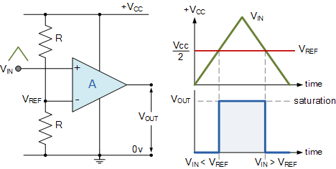
Speed Measurement Analog to Digital Converter (ADC)
Nicholas George
A basic ADC circuit is comprised of comparators. A voltage input (Vin) signal is applied to the input of the comparator, while a reference voltage (Vref) is applied to the other. A comparison of the voltages is made, and the output of the comparator will either be high or low. One comparator could be considered a 1-bit ADC. To increase the bit size of the ADC, comparators are stacked. The general equation is:
n−bit ADC = 2^n−1
The resolution of the ADC and be calculated to find the amount of voltage required to make a change in the digital output.
Vmax / distinguishable outputs
The voltage is read as a fraction of the system voltage. This value is a floating point from 0.0(VSS) to 1.0(VCC). A change in analog input voltage, given by the equation above, will create a change in the digital output voltage by;
1 / distinguishable outputs

Slide 18
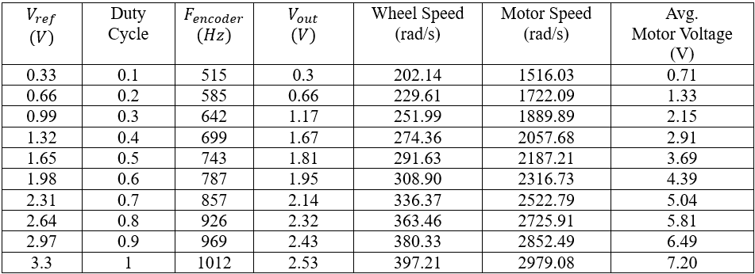
Speed Measurement Results

Slide 19
Results
Driving
Steering

Slide 20
Problems/Solutions
Driving
Steering

Slide 21
Questions
Driving
Steering
Why is the gate driver needed? VGS? VDS?
The gate driver is needed to boost the current supplied by the PWM of the micro-controller.
Why do we use a MOSFET? Why not a BJT?
MOSFETs are voltage-controlled and BJTs are current-controlled. We want a linear relationship between voltage and motor speed. So, we utilize a MOSFET.
In what mode(s) does a MOSFET act as a switch? An amplifier? How does this differ?
MOSFET’s have three modes. Cut-off, triode and saturation. It will act as a switch in the cut-off and saturation region. It will act as an amplifier in the triode region.
Will the circuit in Figure 1 work without the diode? Explain.
The circuit in Figure 1 does not include a diode. It will work without a diode. However, a diode should be placed after the microcontroller to prevent damage to the microcontroller. We don’t want the microcontroller to draw current from the circuit from the motor's internal capacitance.
Why do we use low-side configuration? (Hint: With a 7.2V Battery would the MOSFET turn completely off in high-side configuration? Justify.)
A low side configuration is used due to the low conduction losses given at higher duty cycles. This configuration includes analysis for power loss and has great efficiency with the gate driver.
Why create a linear representation of the final graph?
To better understand the relationship between the output voltage ADC and the distance (m).
It shows the accuracy of the sensors.
What is the operational range of the sensor?
Arduino: 0V-5V
Is there a delay in the sensor and is this delay negligible?
Yes, there is a delay in the sensor, but it is negligible.
What is the purpose of the two diodes in the circuit? Could one of these diodes be removed?
Diodes ae used for conducting the current in one direction (a positive direction).
The Zener diode is not necessary and we did not include it in our circuit design.
What are the four stages of the sensing circuit above?
LC Resonate Circuit
Inductor: L1
Capacitor: C1
Amplification Circuit
Op-Amp (Operational Amplifier): LM324
2 Resistors: R1 & R2
Rectification Circuit
Diode
Peak Detection Low Pass Filter
Capacitor: Cp
Resistor: Rp

Slide 22
Lab 2: Model Identification

Slide 23
General Objectives
Driving
Steering
Apply programming methods in mbed to deepen comprehension of microcontroller functionalities.
Create and execute a circuit dedicated to facilitating the motor model identification procedure.
Confirm the accuracy of the system model through computer-based simulation.
Develop the required circuitry to carry out a step response test on the servo motor.
Gather and document data essential for the estimation of the transfer function.
Apply software tools and the collected data to approximate the transfer function.
Execute the simulation and contrast its outcomes with real-world results.

Slide 24
Main Specifications
Driving
Steering
Motor voltage: 7.4V
Switching frequency: ≥20 kHz
Speed range: 0-100% unidirectional
Design to match the DC motor’s rated voltage
External voltage (speed) reference: 0-3.3V
Feedback: Hall Effect Sensor
Servo voltage: 4.8V - 6V
Communication frequency: 50Hz
Servo Rotational range: 180⁰
Feedback: LC circuit for a given inductance (at 20 kHz)

Slide 25
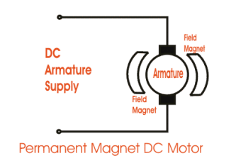
Motor Model ID (Part I) Permanent DC Motor
Nicholas George
A permanent magnet DC (PMDC) motor has poles made of permanent magnets. It consists of:
A permanent magnetic structure that is static
The field produces a magnetic medium
An armature which rotates
The armature produces voltage and torque under the action of the magnetic field
In the design of permanent-magnet DC motors, the flux of a PMDC motor is fixed. And the only way of speed control for PMDC motors is armature voltage control.

Slide 26
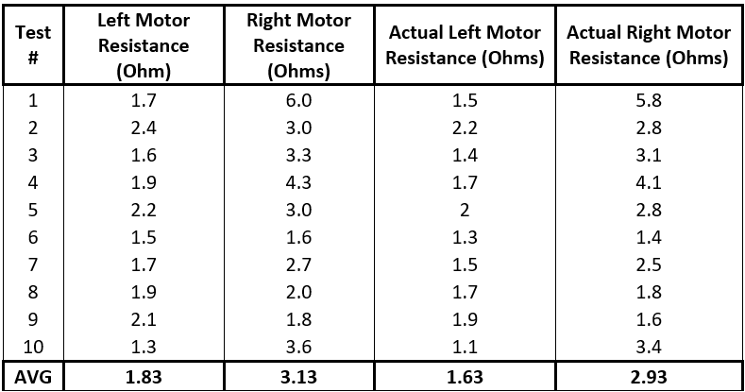

Motor Model ID (Part I) Armature Resistance
Measured the DMM’s lead resistance (0.2 $Ω$)
Resistance was measured at 10 different points along the armature.

Slide 27




Motor Model ID (Part I) Frequency Sweep
1 Hz to 5 MHz spaced in log scale (10 pts/decade)
Measured
Supply voltage, motor voltage, resistor voltage, and phase shift
Calculated
Motor current, impedance, reactance and inductance
$$i_{m}=\frac{V_{R}}{R_{1}}$$
$$Z_{a}=\frac{V_{m}}{i_{m}}$$
$$X_{a}=\sqrt{Z_{a}^{2}−R_{a}^{2}}$$
$$L_{a}=\frac{X_{a}}{πf}$$

Slide 28
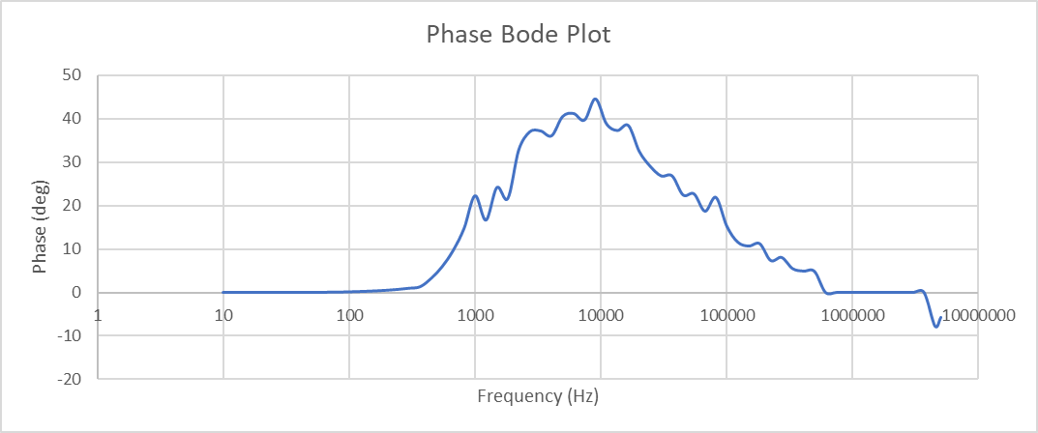

Motor Model ID (Part I) Frequency Sweep Results
Phase Shift was plotted to determine resonant frequency
Best estimation for resonant frequency is 1.35 MHz
$L=156.03 μH$

Slide 29
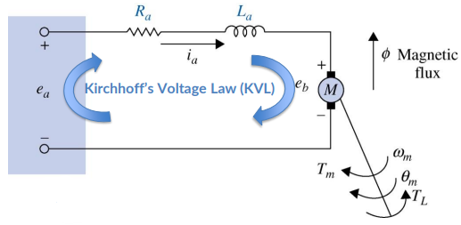

Motor Model ID (Part II) Electrical Motor Model
$i_{a}(t)$: Armature Current
$R_{a}$: Armature Resistance
$L_{a}$: Armature Inductance
$e_{b}(t)$: Back emf
$e_{a}(t)$: Applied Voltage
$$0=e_{a}\left(t\right)−R_{a}i_{a}\left(t\right)−L_{a}\frac{di_{a}\left(t\right)}{dt}−e_{b}(t)$$

Slide 30
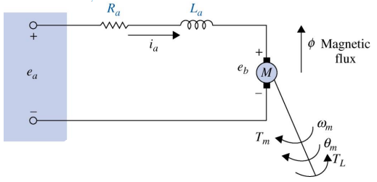


Motor Model ID (Part II) Mechanical Motor Model
$T_{m}(t)$: Motor Torque
$T_{L}(t)$: Load Torque
$θ_{m}(t)$: Angular Displacement
$ω_{m}(t)$: Angular Velocity
$J_{m}$: Motor Inertia
$B_{m}$: Viscous Friction
$$J_{m}$$

Slide 31


Motor Model ID (Part II) Transfer function
Electrical
Mechanical
$$\frac{Ω_{m}}{T_{m}−T_{L}}=\frac{1}{J_{m}s+B_{m}}$$
$$\frac{I_{a}}{E_{a}−E_{b}}=\frac{1}{L_{a}s+B_{m}}$$
Combined
$$\frac{K}{JL_{a}s^{2}+\left(JR_{a}+BL_{a}\right)s+R_{a}B+K^{2}}$$

Slide 32
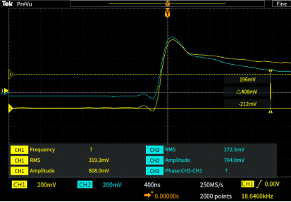
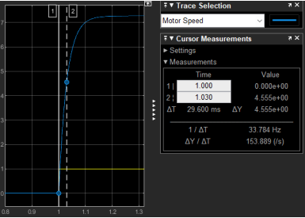
Time constant

Slide 33
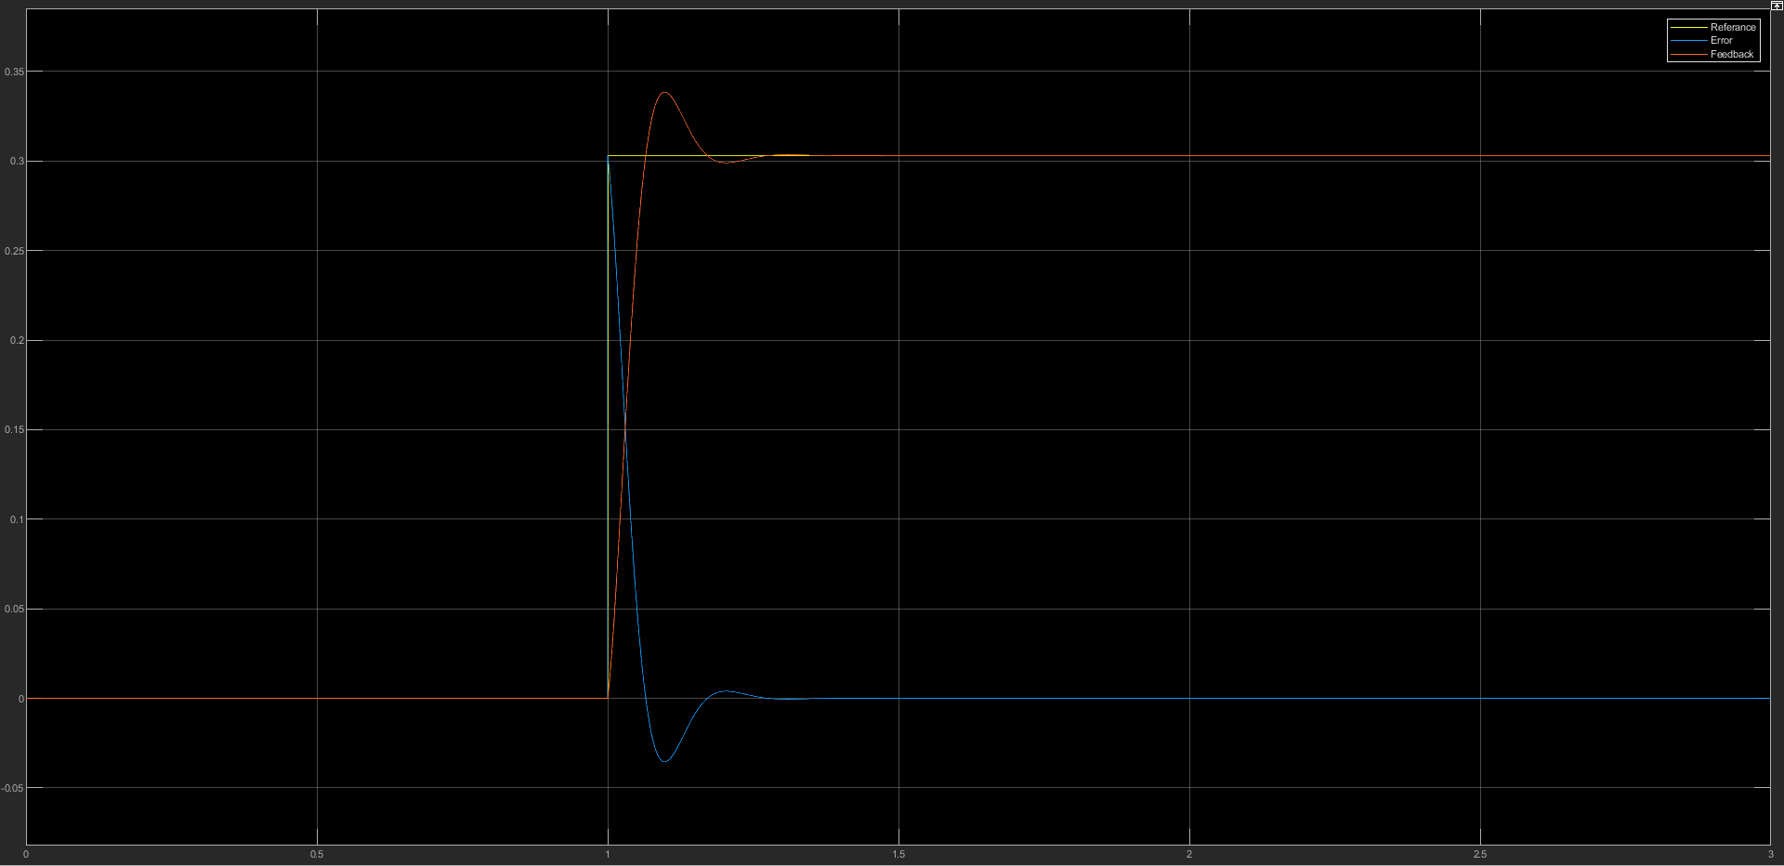
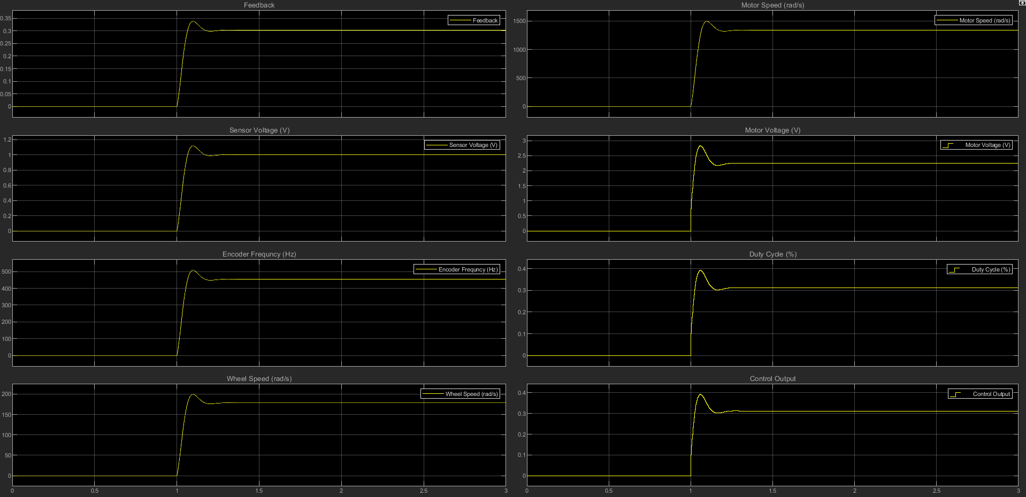
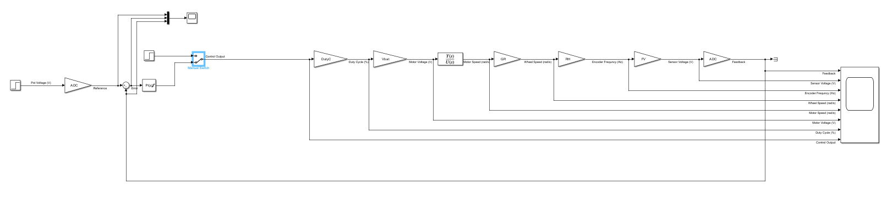
Simulink

Slide 34
Results
Driving
Steering

Slide 35
Problems/Solutions
Driving
Steering

Slide 36
Questions
Driving
Steering

Slide 37
Lab 3: Control Design and Implementation

Slide 38
General Objectives
Driving
Steering
Construct a closed-loop controller for a DC motor and identify essential coefficient values.
Conduct simulations to compare the continuous time response of open versus closed-loop systems using MATLAB.
Assess the system's stability through its transfer function, applying the Nyquist stability criterion.
Execute simulations of the discretized model of the closed-loop system with Simulink software, and then compare these findings to the continuous time results obtained from MATLAB.
Execute the implementation of a microcontroller-based closed-loop control for the DC motor.
Perform comprehensive testing and validation of the full control system.
Develop a closed-loop DC motor controller and establish the required coefficient values.
Perform simulations of the open versus closed-loop system's continuous time response using MATLAB.
Evaluate the system's stability through its transfer function using the Nyquist stability criterion.
Simulate the discretized model of the closed-loop system using Simulink software and compare these results with continuous time outcomes from MATLAB.
Implement a microcontroller-based closed-loop control for the DC motor.
Conduct thorough testing and validation of the entire control system.

Slide 39
Main Specifications
Driving
Steering
Motor voltage: 7.4V
Switching frequency: ≥20 kHz
Speed range: 0-100% unidirectional
Design to match the DC motor’s rated voltage
External voltage (speed) reference: 0-3.3V
Feedback: Reflective Object Sensor
Servo voltage: 4.8V - 6V
Communication frequency: 50Hz
Servo Rotational range: 180⁰
Feedback: LC circuit for a given inductance (at 20 kHz)

Slide 40
Results
Driving
Steering

Slide 41
Problems/Solutions
Driving
Steering

Slide 42
Questions
Driving
Steering

Slide 43
Lab 5: Subsystem Integration- Combination and State Logic

Slide 44
General Objectives
Integrate driving and steering teams.
Implement State Logic for vehicle operation.
System Integration
Hardware: build necessary circuit and input/output.
Software: Combine the functions of driving and steering.

Slide 45
Main Specifications
Driving
Steering

Slide 46
Results
Driving
Steering

Slide 47
Problems/Solutions
Driving
Steering

Slide 48
Questions
Driving
Steering

Slide 49
Lab 6: PID Control Design

Slide 50
General Objectives
Design closed-loop system PID control for whole vehicle.
Controller implementation on one microcontroller and performance analysis.

Slide 51
Main Specifications
Driving
Steering

Slide 52
Results
Driving
Steering

Slide 53
Problems/Solutions
Driving
Steering

Slide 54
Questions
Driving
Steering

Slide 55
Conclusion

